Slide 1
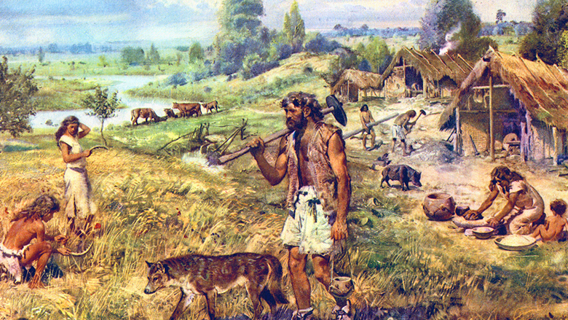
DOMESTICATED BIOTA
GROUP 12 (TOPIC 7)

Slide 2

OUTLINE
1
INTRODUCTION
DOMESTICATED PLANTS
DOMESTICATED ANIMALS
IMPACTS OF DOMESTICATION
BENEFITS OF DOMESTICATED BIOTA
CONCLUSION

Slide 3
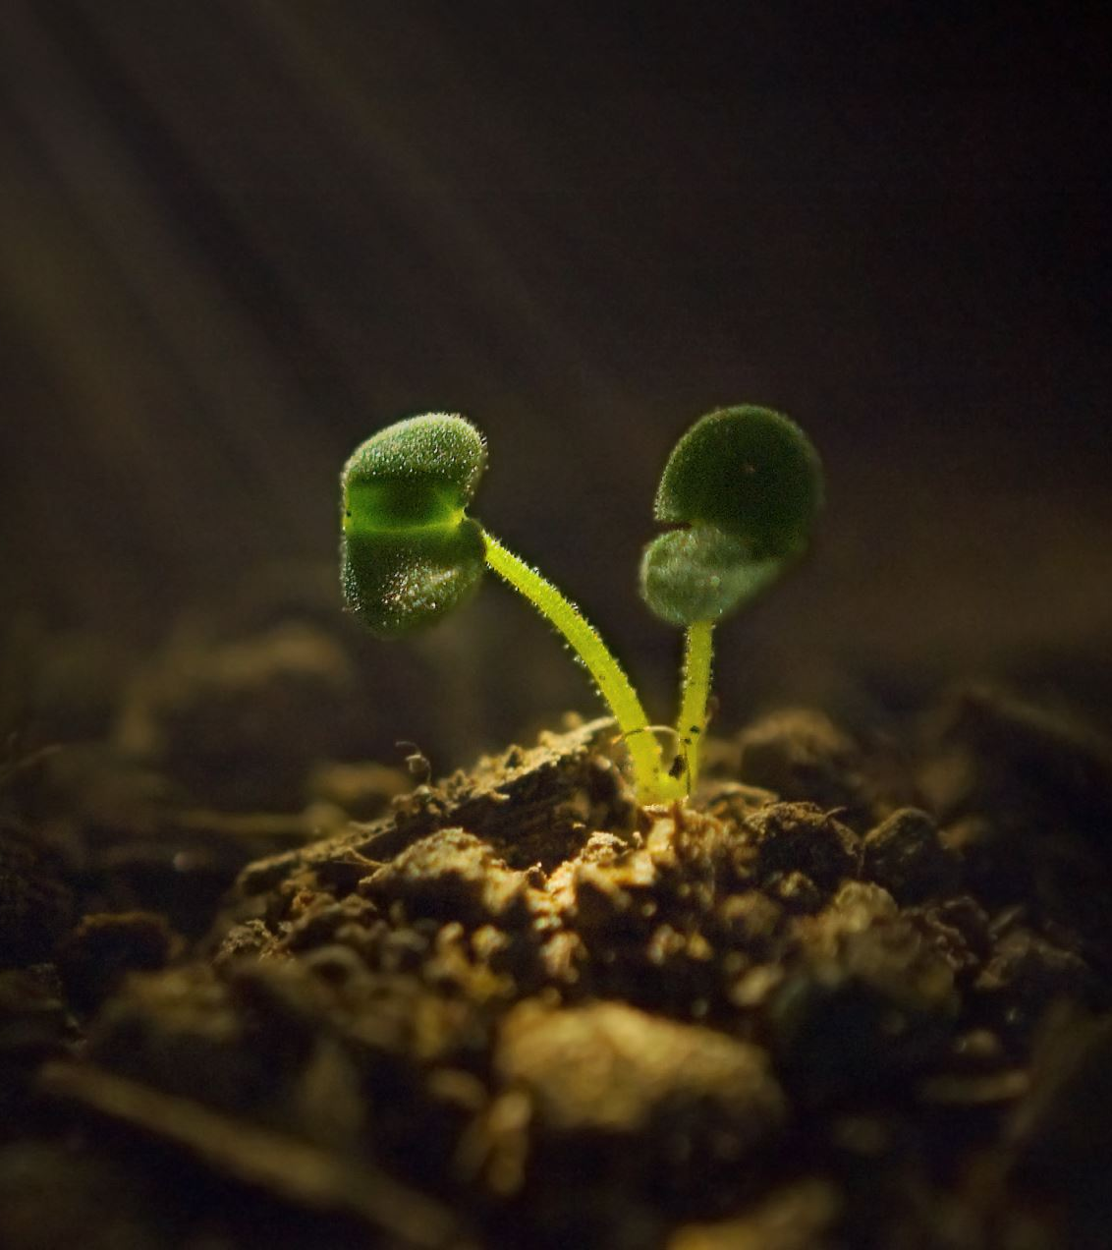
INTRODUCTION
2
Domestication is the hereditary restructuring of wild animals and plants into domestic and cultivated forms based on human objectives.
Domestication of animals and plants appears to have begun in the Old World during the Mesolithic (Middle Stone Age) Period.
It involves the controlled reproduction, cultivation, and management of species for various purposes, such as food production, companionship, transportation, and labor

Slide 4
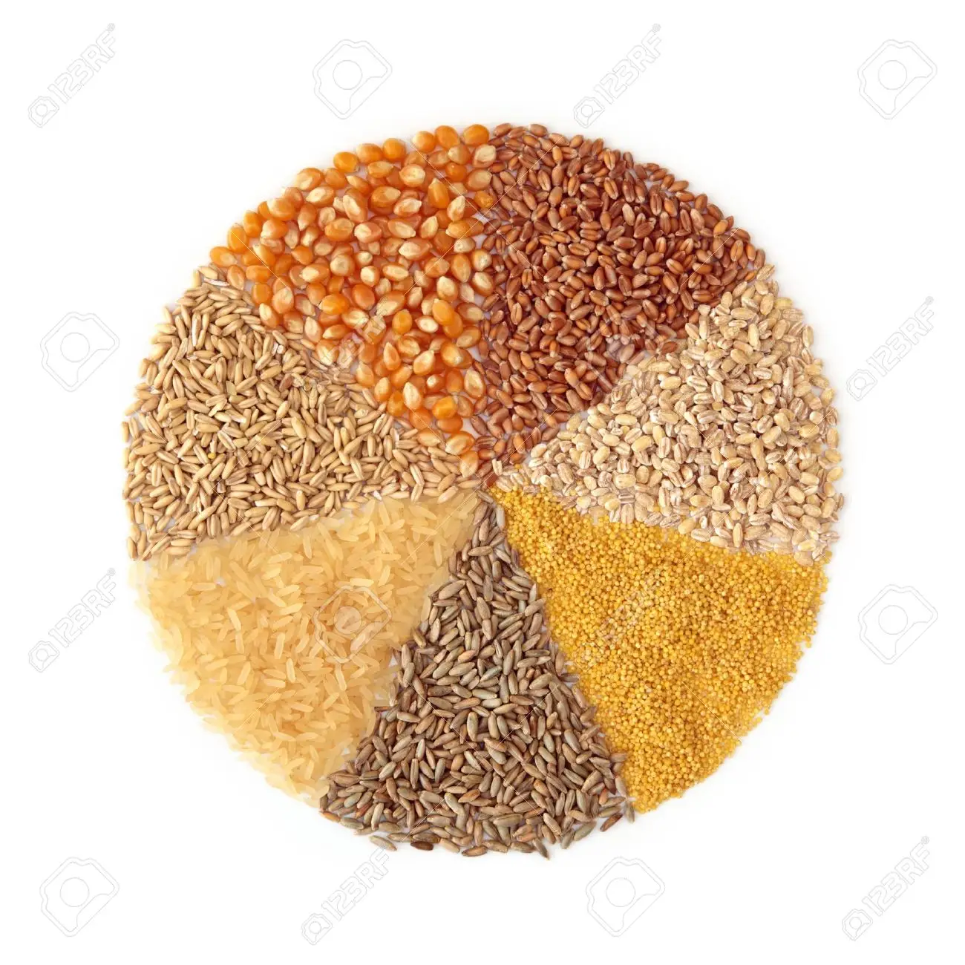
DOMESTICATED PLANTS
3
Plants were domesticated to provide food, medicine, oils, and other products.
Maize (Zea mays): Around 9,000 years ago, maize was domesticated in Mesoamerica. The teosinte wild grass is thought to be its source of origin. Domestication is assumed to have taken place in modern-day Mexico and Central America, while the exact location is still up for contention.
Some plants were domesticated specifically for the manufacturing of narcotics. E.g Tobacco.
Examples of other plants that have been domesticated are; barley (Hordeum vulgare), potatoes (Solanum tuberosum), soybean (Glycine max), rice (Oryza sativa), wheat (Triticum spp.)

Slide 5
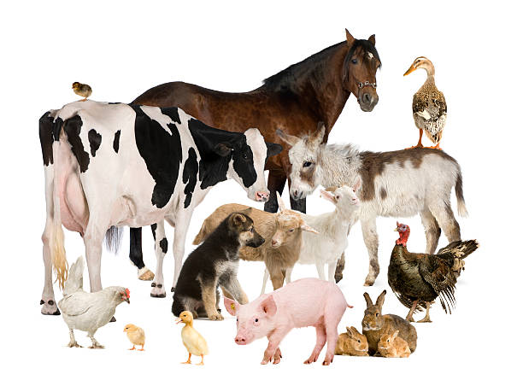
DOMESTICATED ANIMALS
4
Domesticated animals are animals that have been selectively bred and genetically adapted over generations to live alongside humans.
Wolves were the first animal to be domesticated, sometime between 33,000 and 11,000 years ago.
Animal domestication falls into three main groupings:
domestication for companionship (dogs and cats)
animals farmed for food (sheep, cows, pigs, turkeys, etc.)
working or draft animals (horses, donkeys, camels)

Slide 6
IMPACTS OF DOMESTICATION
5
Ecological impacts: habitat loss and fragmentation.
Cultural impacts: central to traditional cuisines, cultural festivals, and rituals, symbolizing cultural identity and heritage.
Socioeconomic: altered ecosystem services.

Slide 7
BENEFITS OF DOMESTICATED BIOTA FOR HUMAN SOCIETES
6
Food security and sustenance
Agricultural productivity.
Economic benefits

Slide 8
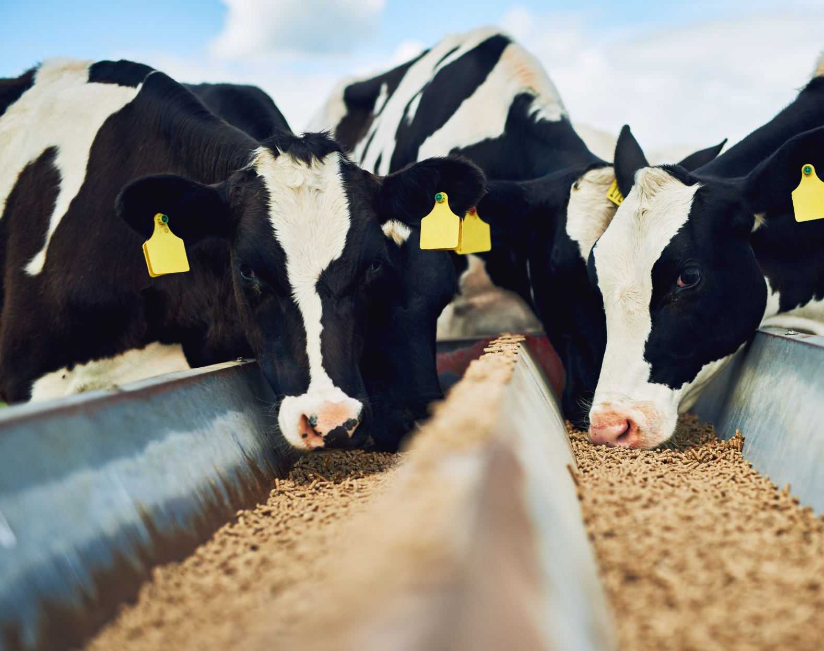
CONCLUSION
7
7
In conclusion, domesticated biota has had profound impacts on human societies and the environment. It has provided a stable food supply, supported agricultural productivity, and contributed to economic development through trade and specialization. However, the process of domestication has also raised concerns such as genetic vulnerability, habitat loss, and animal welfare. Finding a balance between reaping the benefits of domestication and mitigating its drawbacks is crucial for sustainable and responsible stewardship of domesticated biota.

Slide 9
REFERENCES
Badr, A., Müller, K., Schäfer-Pregl, R., & Rabey, H. (2000). On the origin and domestication history of barley (Hordeum vulgare). Molecular Biology and Evolution, 17(4), 499-510.
Jose, S. (2009). Agroforestry for ecosystem services and environmental benefits: an overview. Agroforestry Systems, 76(1), 1-10.
Foley, J. A., DeFries, R., Asner, G. P., Barford, C., Bonan, G., Carpenter, S. R., ... & Snyder, P. K. (2005). Global consequences of land use. science, 309(5734), 570-574.
Diamond, J. (2002). Evolution, consequences and future of plant and animal domestication. Nature, 418(6898), 700-707.
. What is Domestication? | AMNH. (n.d.). American Museum of Natural History.

Slide 10

THANK YOU

Slide 11
GROUP MEMBERS
9215419 OPOKU, William Clinton.
9213419 NKETIA, Korankye Asiedua.
9193419 ABOAGYE, Reena Baaba.
9200819 ANYEMI, Eva Dedaa.
9201119 APPIAH, Josephine.
9199219 AMOH, Godfred.
9210219 KABA, Nicholas Anteromowe.
9212619 MENSAH, Kofi Agyei.
9207119 DUAH, Georgina.
9209319 HENAKU, Boateng Oforiwaa Priscilla.

